Slide 1
Cs 103 Project
Sohaib Nasir
2021609
Departmental Store System

Slide 2
Problem statement:
Title: Departmental Store System
Description: In a departmental store, the software will be able to track inventory of the stock. At each transaction, the inventory will be updated.

Slide 3
Introduction:
Introducing Departmental Store System:
My project was to use C++ language to make an inventory management system which had the functionality that a system at a departmental store should have.

Slide 4
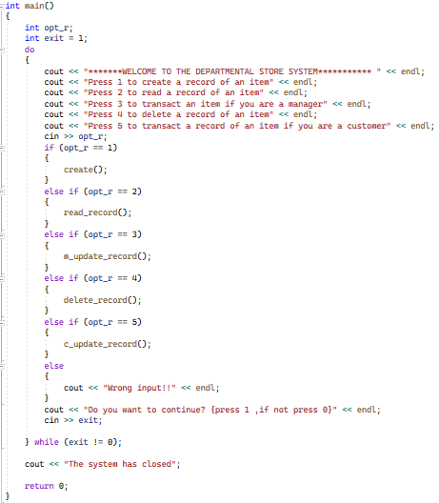
Algorithm and code description:
Int main() function :

Slide 5
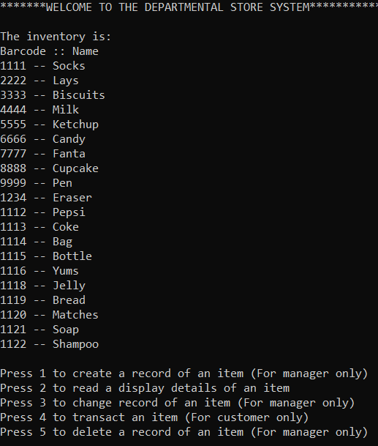
Execution:

Slide 6
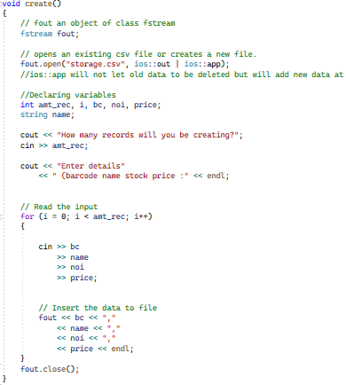
create function :

Slide 7
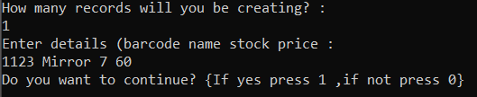
Execution:
The numbers of records of items to be created are asked.
The details are entered.

Slide 8
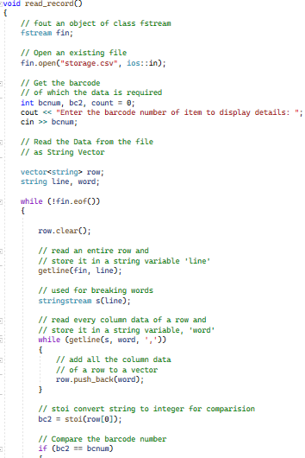
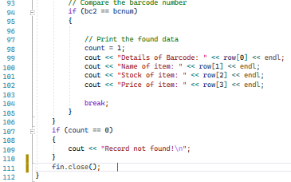
read_record function:

Slide 9
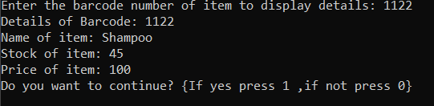
Execution:
The user has to only enter the data.
Then Name, Stock, and price of item is displayed.

Slide 10
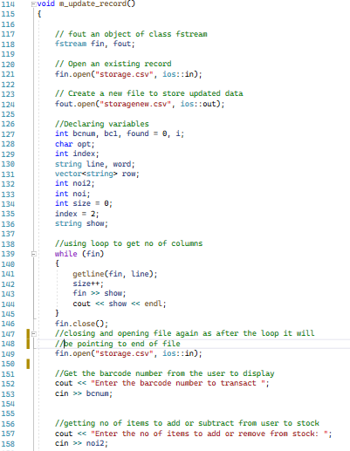
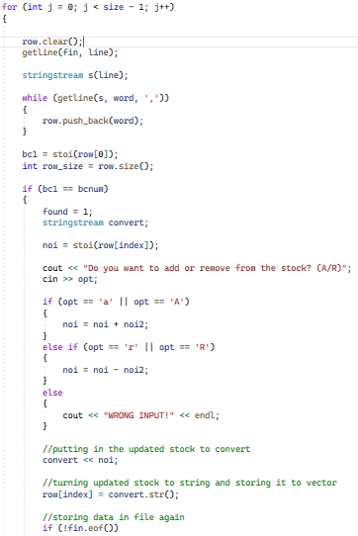
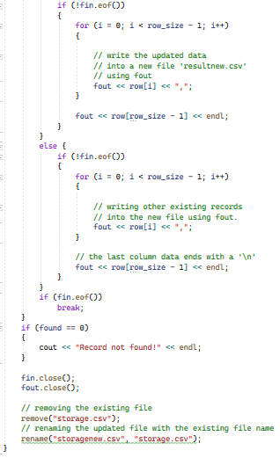
m_update_record function:

Slide 11
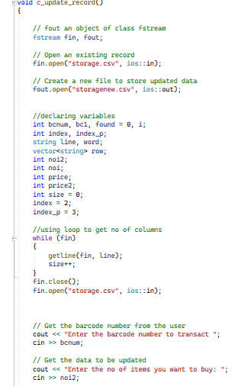
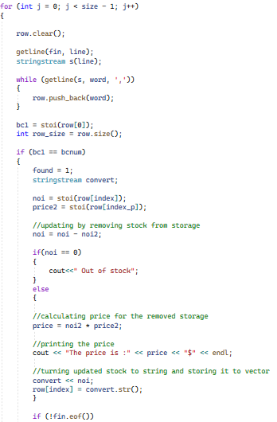
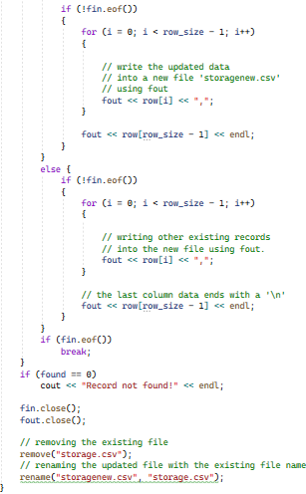
c_update_record function:

Slide 12


Execution(Update manager):

Slide 13

Execution(Update customer):
In the background, as the customer does not have to know, the stock is updated.
The price is displayed for the current item.

Slide 14
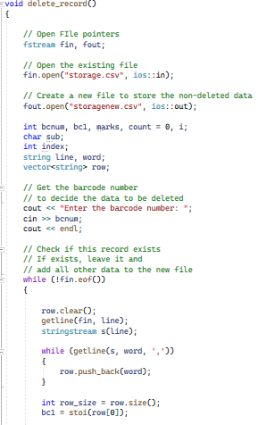
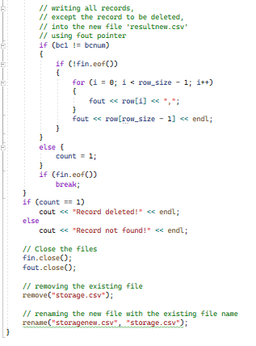
delete_record function:

Slide 15

Execution:
The barcode of the item to be delete from the stock in the system is entered which if the record exists deletes it.

Slide 16
CONCLUSION:
In conclusion using C++ programming language features such as file handling, conditional statements, loops, functions etc. I have made a departmental store system.

Slide 17
THANK YOU

